Slide 1

Madison County
BUDGET PROCESS
Presented on March 19, 2024
JMU Project
Jennifer Warren, Finance Director

Slide 2
Key Players in Budget Process
Finance Director
Treasurer & Commissioner of Revenue
Department Heads
County Administrator & Assistant County Administrator
Board of Supervisors
Madison County School Superintendent
Madison County Finance Director
Madison County School Board

Slide 3
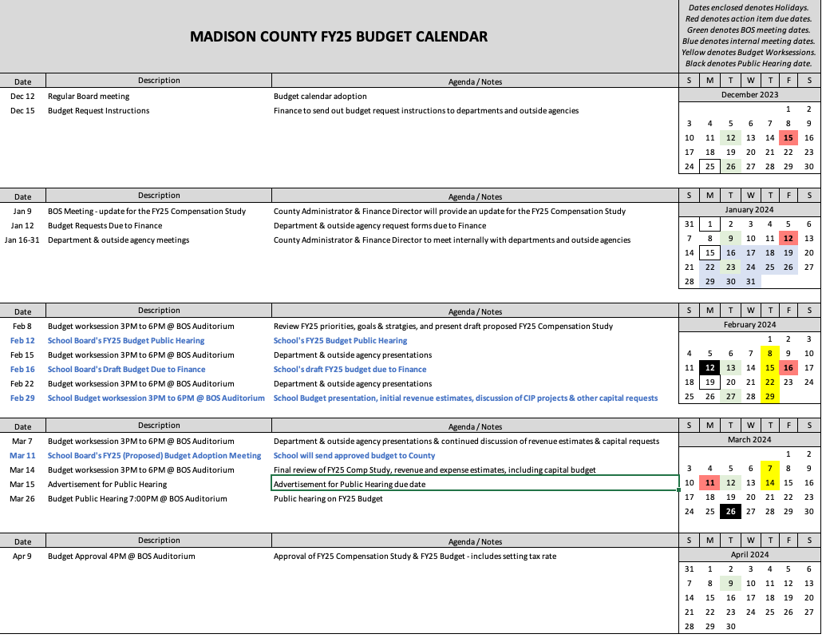
STEP 1 – CREATE BUDGET CALENDAR

Slide 4
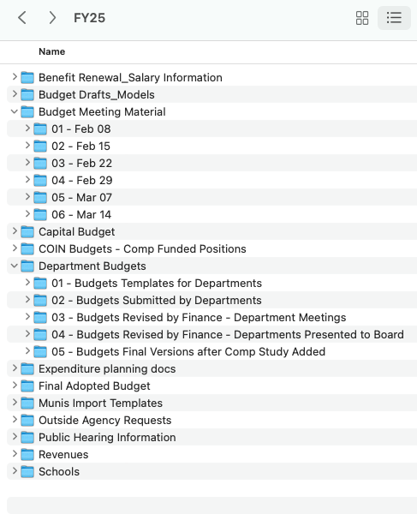
STEP 2 – CREATE ONE DRIVE FOLDER STRUCTURE
FILE NAMING & VERSION CONTROL IS CRITICAL!

Slide 5
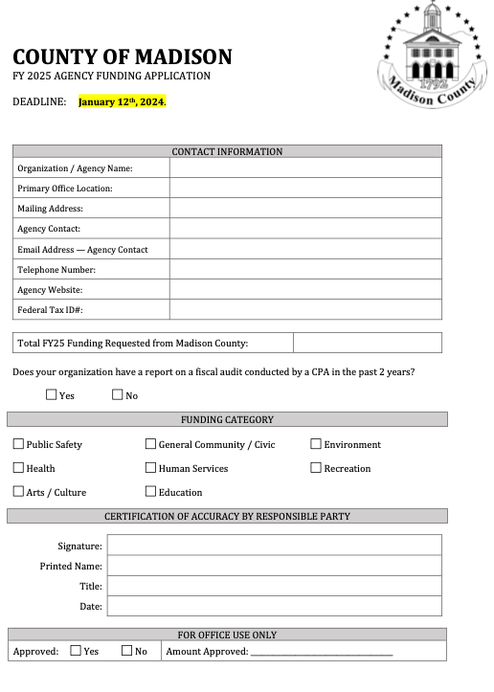
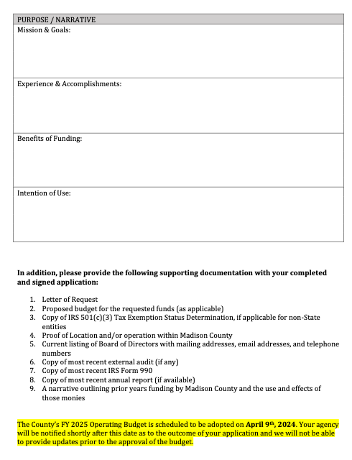
STEP 3 – SEND OUT OUTSIDE AGENCY APPLICATION
USE SMARTSHEET
FOR TRACKING
INCOMING REQUESTS

Slide 6
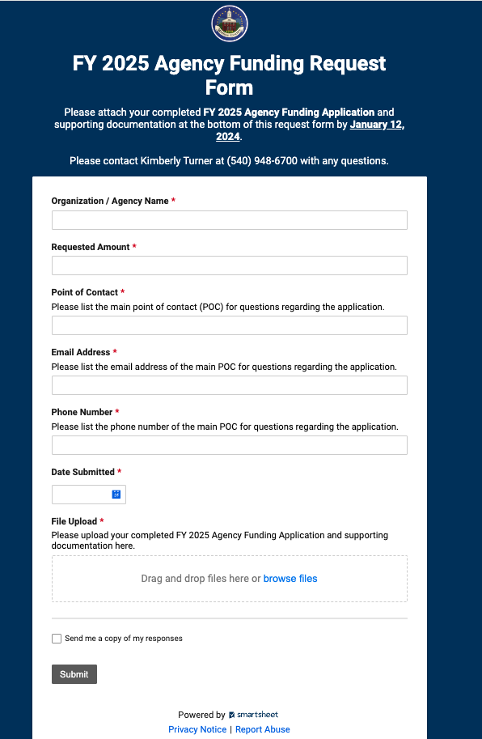
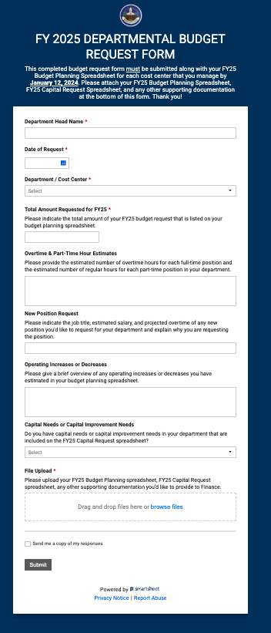
STEP 4 – SETUP SMARTSHEETS FOR TRACKING APPLICATIONS Smartsheet is an enterprise work management platform that allows you to collaborate, manage, and report on work in real time, automate workflows, and deploy new processes at scale.

Slide 7
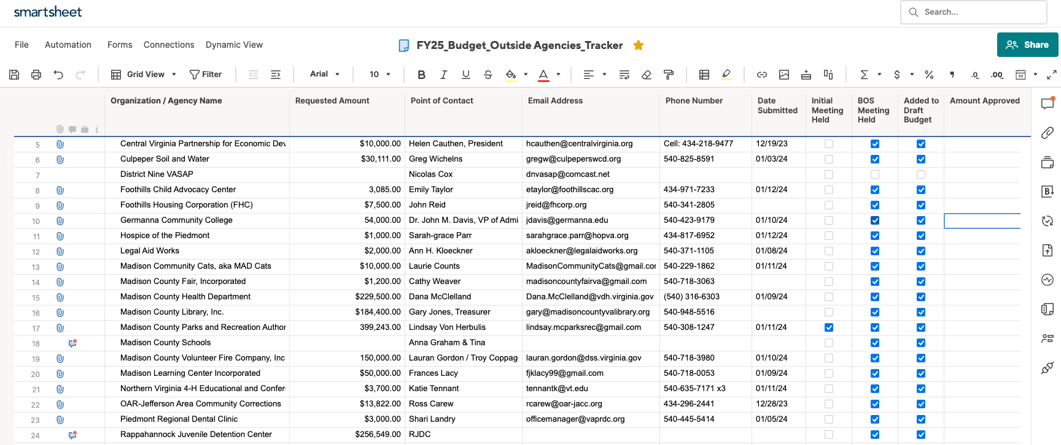
SMARTSHEET (cont.)

Slide 8
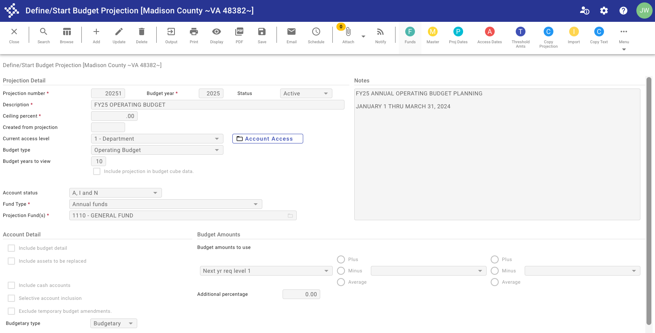
STEP 5 – DEFINE/START BUDGET IN ERP SYSTEM
Our ERP System is Tyler Munis. The Budgeting Module in Tyler allows us to create budgets inside Munis and export budget templates for department heads to complete and return for import.

Slide 9
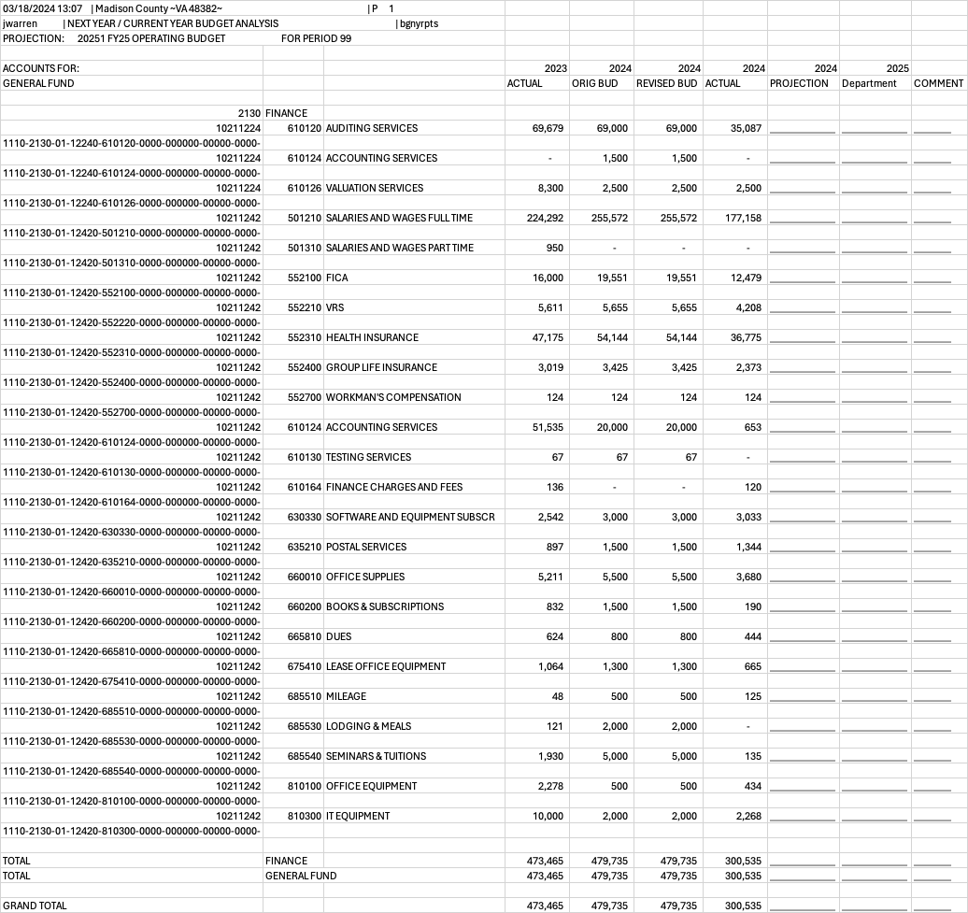
EXAMPLE DEPARTMENT
BUDGET TEMPLATE FROM
ERP SYSTEM

Slide 10
STEP 6 – MEETING WITH DEPARTMENT HEADS & OUTSIDE AGENCIES
Ensure budget requests/projections are consistent with last 3 years actuals.
Talk through and notate any increases or decreases to a budget line item.
Finalize draft budget projection for each department with department head.
Validate that Outside Agencies have submitted their most recent Form 990.
Review any capital expenditure requests from departments for Capital Budget.
Set a date/time for Department Head and Outside Agencies to present their requests to BOS.

Slide 11
STEP 7 – MEETING TO DISCUSS REVENUES
Send Revenue Budget Template to Treasurer & Commissioner of Revenue (COR) to determine the budget revenue figures.
Meet with Treasurer & COR to discuss their projections.
Ask COR to provide scenarios of extra revenue if taxes were increased (PPT and real estate).
Gather revenue figures for comp board funded positions.
Gather grant information from department heads.

Slide 12
STEP 8 – CREATE BUDGET WORKBOOK
Add Department Budgets & Revenue Projections into Budget Workbook as a separate tab each.
Ensure VLOOKUP formulas in ‘Expenditures’ and ‘Revenue’ tabs are correct.
Enter School Board proposed budget figures into workbook.
Enter Outside Agency requests into workbook.
Ensure that all funds are balanced.
Determine the Opening Balance Appropriation needed (if any) for the General Fund to balance.
Gather information from the surrounding counties regarding proposed tax increases.

Slide 13
STEP 9 – HOLD BUDGET WORKSHOPS
Workshop #1 - Priorities, Goals, Strategies, COLA, Capital Improvement Projects
Workshop #2 - Outside Agencies present requests to BOS
Workshop #3 - Department Heads present budget requests to BOS
Workshop #4 - School Board presents budget
Treasurer & Commissioner of Revenue present revenue projections to BOS
Workshop #5 - Department Heads present budget requests to BOS (continued)
Workshop #6 – County Administrator and Finance Director present the draft Administrative Budget and Capital Budget

Slide 14
STEP 10 – FINAL STEPS
Create a PowerPoint presentation for the Board of Supervisors to review the recommended Operating Budget as well as the Capital Budget.
Prepare Public Hearing Notice & Advertise
Hold Public Hearing
Adopt Budget and set tax rates
Create Budget Book

Slide 15
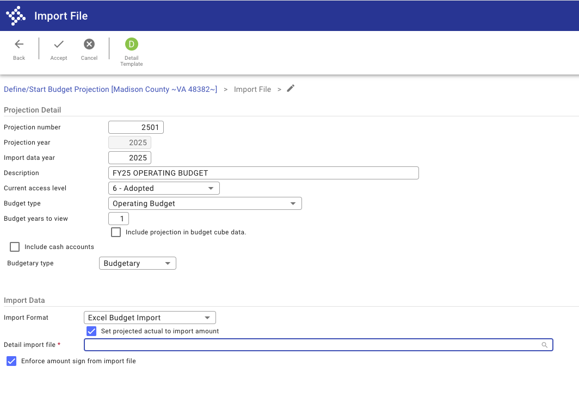
STEP 11 – IMPORT DATA INTO ERP SYSTEM

Slide 16
SURROUNDING COUNTIES

Slide 17
QUESTIONS?

